Slide 1
Building chatbots with MS Bot Framework
Getting Started

Slide 2
Getting started
Visual Studio 2017 - Free Community version or higher
Bot Template for Visual Studio
Bot Framework emulator
Luis.ai account
Botframework account
Microsoft Azure account

Slide 3
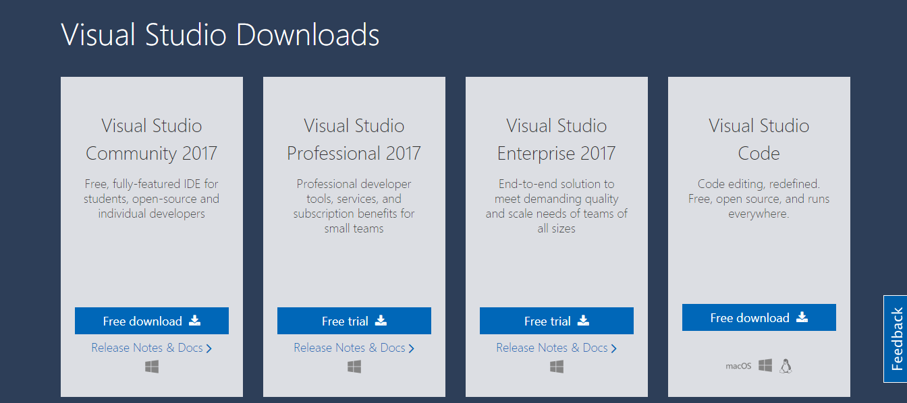
https://www.visualstudio.com/downloads/

Slide 4
Download from Microsoft
Bot Application.zip http://aka.ms/bf-bc-vstemplate
Bot Controller.zip http://aka.ms/bf-bc-vscontrollertemplate
Bot Dialog.zip http://aka.ms/bf-bc-vsdialogtemplate

Slide 5
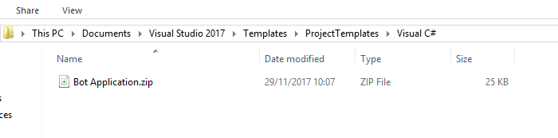
Setup the templates in Visual Studio
Copy “Bot Application.zip” to Visual Studio Project Template, Visual C# folder
Move the downloaded file to this folder
DO NOT UNZIP

Slide 6
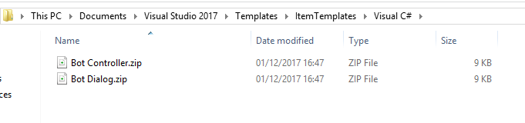
Setup the templates in Visual Studio
Copy “Bot Controller.zip” and “Bot Dialog.zip” to Visual Studio Project Template, Visual C# folder
DO NOT UNZIP
Move the downloaded file to this folder

Slide 7
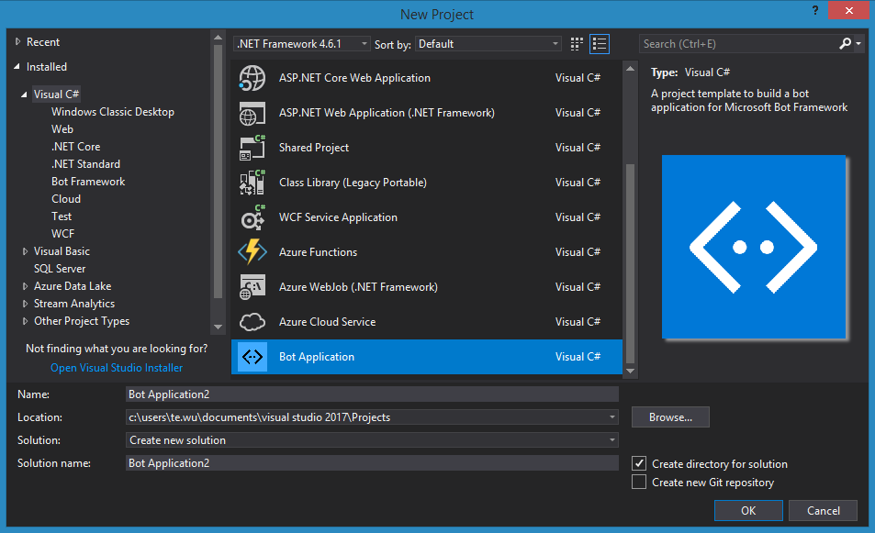
In visual studio, start a new project.
You should see a “Bot Application” template in Visual C# top panel

Slide 8
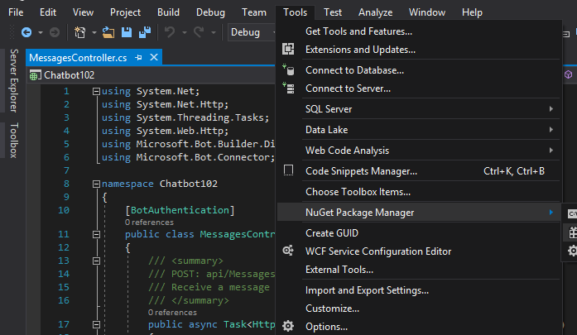
Once the project is loaded.
Go to NuGet Package Manager.
Make sure all the packages are updated to the latest version

Slide 9
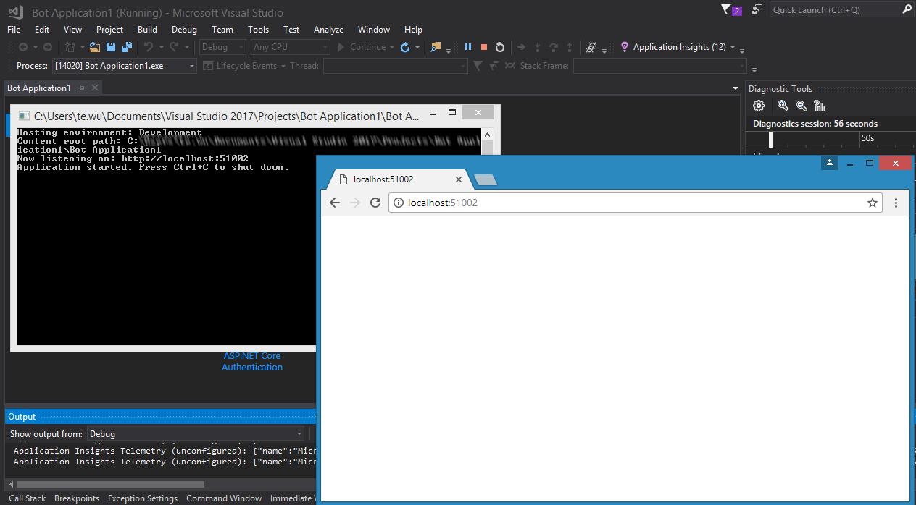
Start the application
Make a note of the app URL

Slide 10
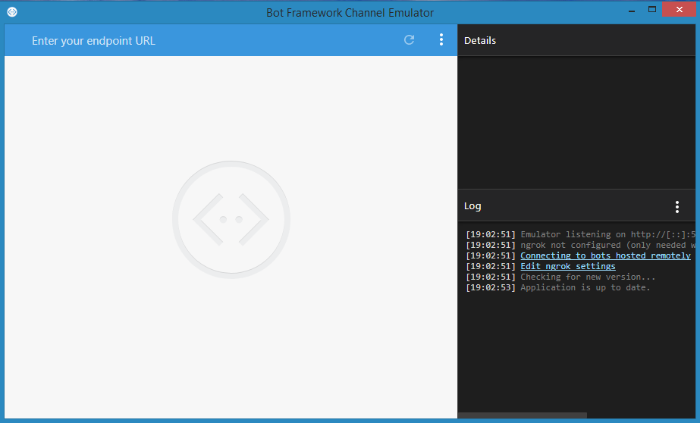
Start Bot Framework Emulator

Slide 11
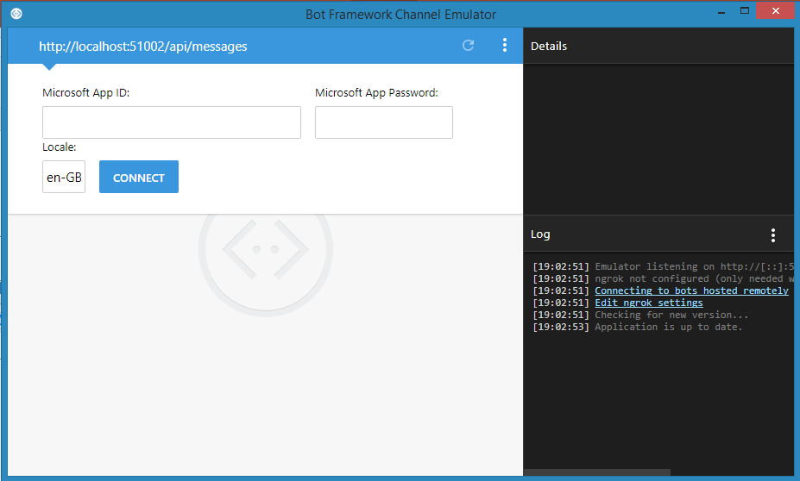
Key in your URL “{bot app url}/api/messages”
Then click connect

Slide 12
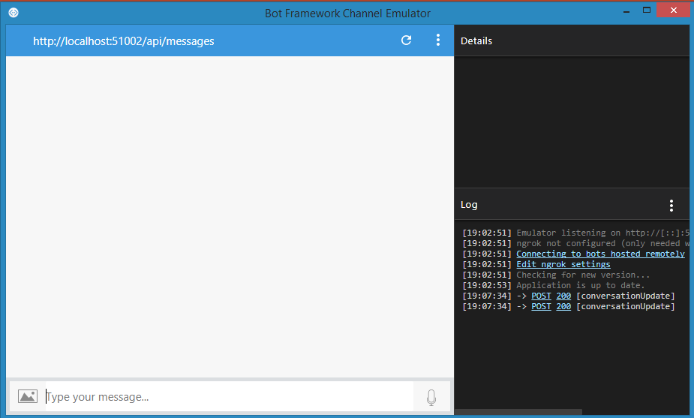
Your should see this

Slide 13
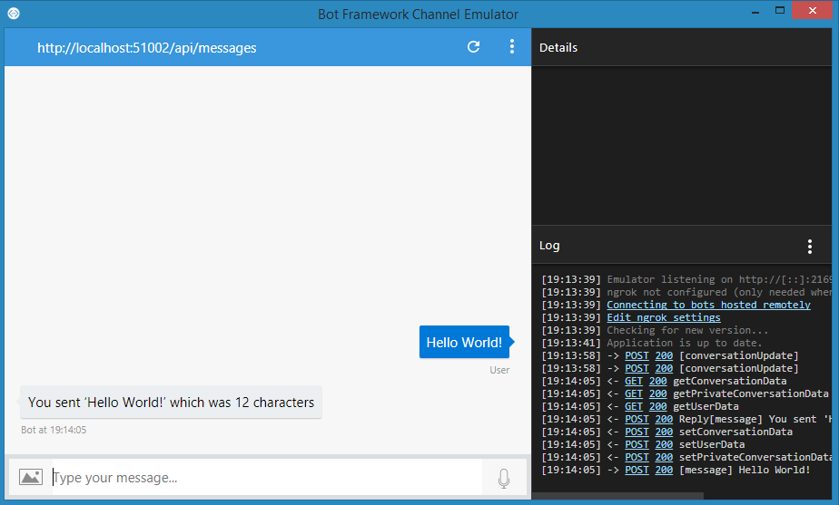
Type “Hello World” and if you see the bot respond.
Congratulations! You’ve just created your first bot
and ready for the next step!

